Slide 1
Playing Chinese Checkers with Reinforcement Learning
Sean Xiong, Bill Zizek, and Alexandra Yue
Notes:
Good morning everyone! My name is Bill and alongside my group members Sean and Alex, today we’re going to be talking to you about our efforts in playing chinese checkers with reinforcement learning.
---
1 min + Agenda + Objectives

Slide 2
Objective
To have an intelligent agent which outperforms the strategy of other players in Chinese Checkers
Notes:
So our objective was simple - we wanted to have an intelligent agent which could outperform the strategy of other players - computer or human - in Chinese Checkers!
---
1 min + Agenda + Title

Slide 3
Agenda
About the game
Approaches
Takeaways
Notes:
First off we’re going to briefly discuss the structure of the game to contextualize the rest of the work. Following that, we’ll discuss some various approaches to creating intelligent agents we implemented. Then we’ll mention some takeaways and summary of the work and what lays ahead.
---
1 min with 2 previous slides

Slide 4
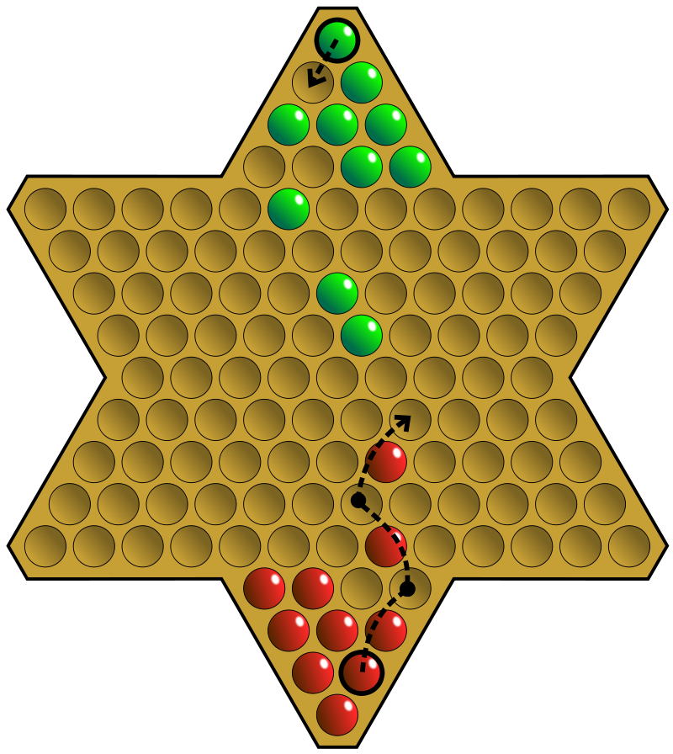
About the Game
1
Goal
Move all pieces completely to opposite corner
Rules
Can move one step to neighbouring cavity if not occupied
Can hop across other pieces until no piece is around beside the one that it came from
In our project - we confined the game to one vs one mode
Winning Condition
The first player to reach the opposite corner of the board
2
Notes:
So fun trivia fact - Chinese Checkers is actually not a variation of traditional checkers now is it from China… Chinese Checkers is a strategy board game from Germany! Then when it was brought to America it was renamed to Chinese Checkers as part of a marketing scheme.
Now the principle of the game is fairly simple, you have to try and get all of your pieces into the star corner on the opposite end of the board before your opponent does the same. In our variation we have simplified it to 2 players but in reality you can play with up to 6 players.
Players take turns moving a single piece - either by moving one step in any direction to an adjacent empty space or by jumping in one or any number of available consecutive hops over other single pieces.
---
1 min

Slide 5
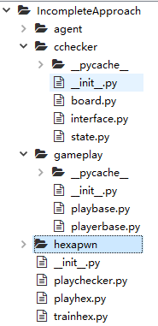
Approach
Project Roadmap
Start with the skeleton for Hexapawn
Convert to the board for Chinese Checkers
Evaluate multiple approaches to find the best agent
Notes:
In this project, we really didn’t want to reinvent the wheel. So for building the actual board and game environment we just started off with the hexapawn game board structure. From there, we converted the board to be conducive to the pieces for Chinese Checkers. Finally in the roadmap, we then needed the ability to evaluate multiple agents to find which one performed the best.
---
1 min

Slide 6
Approach
Sophisticated Agents
Minimax with α-β Pruning
Monte Carlo Simulation
Q-learning
Heuristic Guided Monte Carlo Tree Search
Simple Agents
Random
Simple Greedy
Notes:
We looked at various levels of agents. We needed something simple + automated to compare against so we used 2 simple agents. A “Random” agent which chooses it’s next move randomly. Then, a simple Greedy agent which makes no regard for how the opponent might act and solely makes decisions to maximize reward. So we won’t have time to go in depth on each agent and all the results but we’ll talk about what we can.
---
0.5 min

Slide 7
Minimax with α-β Pruning
Minimax is a recursive Adversarial Search method that maximizes the minimum value of an opponent’s possible moves
Alpha-beta pruning decreases the number of nodes evaluated
The value of each leaf board state is approximated by a linear evaluation function based on
Total distance to the destination corner
Total distance to the vertical central line
Sum of vertical advances
Notes:
First off for us to chat about is using minimax with alpha-beta pruning. Now we are all already familiar with minimax so we won’t dwell on it too much.
A minimax algorithm is a recursive algorithm for choosing the next move in a game. A value is associated with each position or state of the game. This value is computed by means of a position evaluation function and it indicates how good it would be for a player to reach that position. The player then makes a move that maximizes the minimum value of an opponent’s possible moves. Minimax can be thought of as exploring the nodes of a game tree. So this is well suited for a game like Chinese Checkers.
However in addition to old fashioned minimax, we wanted to implement alpha–beta pruning. Really what this is, is a search algorithm that seeks to decrease the number of nodes that are evaluated by the minimax algorithm in its search tree. It stops evaluating a move when at least one possibility has been found that proves the move to be worse than a previously examined move. When applied to a standard minimax tree, it returns the same move as minimax would, but prunes away branches that cannot possibly influence the final decision. So we’re focusing on the “more promising” sub trees.
Why is this important? Well it reduces the complexity of the minimax tree which results in significantly faster computational time.
---
1.5 minutes

Slide 8
Q-Learning and Monte Carlo Simulation
Q-Learning reinforcement learning method
Agent needs to have a matrix of values for states to achieve optimization
In our case - limit the maximum moves to get reasonable training time
Monte Carlo simulation
Game is played by starting in a random state (not necessarily the beginning) and plays until the end.
This agent was evaluated separately against a Random and Greedy Player
Notes:
So we actually ran into a bit of difficulty implementing Q Learning in our Chinese Checkers framework. For each movement - the cavity’s value is difficult to calculate as it might end up being used by a different piece, among other considerations. So in consideration of time and our limited resources we chose to focus on other agents.
A Monte Carlo simulation is actually a nice and simple approach that has value when applied to Chinese Checkers. The agent plays the game by starting in a random state (not necessarily the beginning) and plays until the end. This is all while recording states, actions, and rewards within the confines of the game. So a caveat is the simulation might not visit all states of the game and this has to be kept in mind. The agent was evaluated separately against a Random and Greedy Player as described. Let’s have a look how it performed...
---
1.5 minutes

Slide 9
Monte Carlo Simulation
The agent plays the game by starting in a random state (not necessarily the beginning) and plays until the end
While recording states, actions, and rewards within the confines of the game
Caveat is the simulation might not visit all states of the game
The agent was evaluated separately against a Random and Greedy Player
Results: The agent suffered some defeats but over the long run the agent will have a higher win % than the greedy player
Notes:
---
1.5 minutes

Slide 10
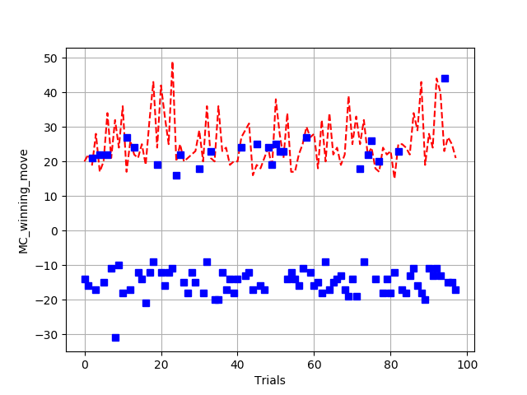
Monte Carlo Simulation Analysis
We see the MCS agent outperform the Random moving player as expected
The Greedy player outperforms the MCS agent in the short term
The MCS agent potentially could not have reached all game states
MCS Agent vs Computer Player
MCS Win
Random
Greedy
MCS Loss
Notes:
X-axis is number of Trials, Y- axis is Number of moves that finished the game. Positive move in y-axis means Monte Carlo player wins, negative means Monte Carlo Player loses. Red dash represent the game between Monte Carlo player vs Random player. Blue Dot represent the Monte Carlo player vs Greedy Player.
As we could see in the Exhibit, Random player has 0 chance to win, where Greedy player have higher chance to win than Monte Carlo player.
---
1.5 min w/ previous slide
The agent suffered some defeats but over the long run the agent will have a higher win % than the greedy player

Slide 11
Monte Carlo Tree Search
The general idea behind a MCTS is simple - given the state of the game, choose the most promising move
Four Phases
Selection
Expansion
Simulation
Backpropagation
Notes:
In this approach, the AI Player is way more sophisticated than a greedy player and well trained through playing hundreds of games against itself. As a result of this, it has a high chance to beat the greedy player over a long run. This is done in part through a heuristics-guided Reinforcement Learning and Monte Carlo Tree Search (MCTS).
The general idea behind a MCTS is simple - given the state of the game, choose the most promising move. A MCTS consists of four phases: selection, expansion, simulation, and backpropagation. The algorithm starts at a root node and moves down the action tree until a leaf node is reached. Then, if the leaf node does not terminate the game then more child nodes are created according to available actions. Next the simulation phase involves taking random actions to get to a new state. This is done until a terminal state is reached. The value of the terminal state is then back propagated and the involved nodes are updated with the simulation results while tracking the number of visits to each node. MCTS search doesn't require any knowledge about the domain but can take many iterations to converge to a good solution.
---
1.5 min w/ next slide

Slide 12
Summary
Chinese Checkers is a strategy board game with the objective to be the first player to race all game pieces to the opposite corner
Multiple agents
Minimax algorithm with alpha-beta pruning
Q Learning
Monte Carlo Simulation
Monte Carlo Tree Search
Future
More computational resources would be utilized for long-term evaluation of agent performance - especially MCTS
Full evaluation of all agents
Notes:
So just to wrap things up - Chinese Checkers is a strategy board game with the objective to be the first player to race all game pieces to the opposite corner. It is a perfect game for reinforcement learning that is more advanced than something like hexapawn but can still be controlled to a certain degree so it can be within reason.
We had a look at quite a few different agents in our work. Unfortunately we ran into difficulty completing some due to lack of resoures, but we did see some pretty cool results from the others. Given extended time, it would be really profound to have a look at how all these approaches measure up against each other given extended training time. Of course with this would require more computational resources but the theory behind agents like MCTS point towards it paying off.

Slide 13
Thanks!
Notes:
So hope you all enjoyed the talk, thanks to Larry for a great semester and thank you to everyone here for listening!

